Slide 1
Requirements Engineering – Part 2

Slide 2
Documenting Requirements
It's no good going to all that effort collecting reqs
If you then just go away and forget them !
Clearly we need to record them in some way
So they’re understandable to all members of team
And also system stakeholders (to aid in validation)

Slide 3
Requirements as Contract
Formalised / explicit requirements documents may be part of contract between developer and client
Basis of the agreement on what is to be delivered
More importantly, what is beyond scope of project
An issue which Agile methods tend to gloss over !

Slide 4
Notations

Slide 5
Tips for Natural Language Reqs
Give each requirement a unique identifier (alphanumeric)
Use text highlighting to identify key elements
Use language in a consistent way
Use "shall" or “must” for mandatory requirements
Use "should" for desirable requirements
Avoid the use of technical jargon
Ensure reqs are atomic (can't be broken down)
Where appropriate, include a rationale for why a requirement is necessary (to aid prioritisation)

Slide 6
Example Requirements
SENSE-3.2 The system shall measure the blood sugar level every 10 minutes. (Changes in blood sugar are relatively slow so more frequent measurement is unnecessary; less frequent measurement could lead to unnecessarily high sugar levels.)
SAFE-5.6 The system shall run a self-test routine every minute with the conditions to be tested defined in Table 1. (A self-test routine can discover hardware and software problems and alert the user to the fact the normal operation may be impossible.)

Slide 7
Quality Attributes of Requirements
Validity: Do requirements represent what stakeholders actually want/need ?
Consistency: Are there conflicts between reqs ?
Completeness: Have all features been included ?
Realism: Can the requirements be implemented given available resources and technology ?
Verifiability: Can requirements be “ticked off” ?
Comprehendability: Can req be understood ?
Traceability: Is the origin of req clearly recorded ?

Slide 8
Structuring the Process of Elicitation
It's hard to go about elicitation without support
A big gap between real world and atomic reqs !
Developers often use "Use Cases" to aid transition
Useful thought tool to structure elicitation activities
Provides top-down systematic decomposition…

Slide 9
Stages in Use Case Req Specification
1: Identify "actors" - those interacting with system
2: Identify top-level use-case goals of the actors
3: Break down these goals into individual steps
4: Specify atomic requirements for each step

Slide 10
Example: Restaurant

Slide 11
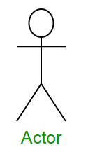
Stage 1: Identify Actors
Waiter
Chef
Cashier
Client

Slide 12
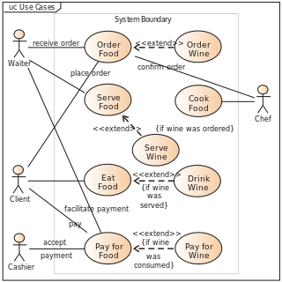
Stage 2: Identify Goals (and actions)

Slide 13
Stage 3: Identify “Flow” steps
Let's consider the “Order Food” goal
Basic flow - Normal sequence of steps to achieve goal:
Consider menu
Select starter and then main
Attract waiter
Place order
Waiter passes order to chef
Chef confirms order
Alternative flow - Other common sequence of steps:
Sometimes you choose the main course first, then starter !
Exceptional flow - Cope with undesirable behaviour:
You see the price of the food and slip away quietly !

Slide 14
Stage 4: Specify Atomic Reqs
Each step can then be considered in detail
Atomic functional & non-functional reqs defined
For example: "restaurant client shall be able to browse though all available starters"
Recorded in a suitable notation
(natural lang., graphical model, mathematical)

Slide 15
Detail and Complexity
Specifying all the atomic requirements in detail is a very time consuming and expensive activity
Some light-weight development processes leave atomic reqs implicit (i.e. Stage 4 is not done at all !)
Others fully specify just critical aspects of system
Depends on type of system & formality of process
Building a dating app is very different from a drive-by-wire system in an intelligent vehicle !
You have to decide what level is right for you :o)

Slide 16
Agile
On the face of it, Agile seems to totally ignore the specification of requirements :o(
Don't be fooled – reqs are specified in detail !
The notation used is automated test scripts !!!
Tests are created before coding begins (like reqs)
The system is continually verified against them
Tests ARE formally specified atomic requirements !

Slide 17
What Next ?
Once we have identified (at least some) reqs
The next step is to build something to fulfil them
We could just lash down some code without delay
Better to devise an elegant high-level structure first
A good overall design helps greatly in maximising Maintainability, Efficiency, Security etc.
This will be the topic of the next segment of this unit

